Slide 1
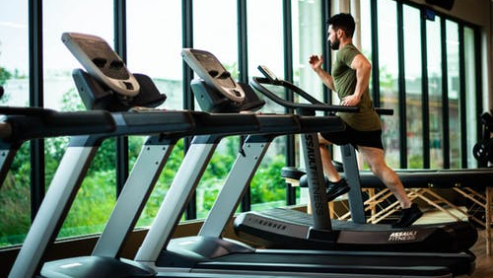
GYM MANAGEMENT SYSTEM

Slide 2
PROJECT ADVISOR
1. PRASAD SIR
2. DEBASHISH SIR

Slide 3
TEAM MEMBERS :
1. SHIVANGI TYAGI
2. SUHAIL
3. SACHIN SHARMA
4. AYUSH

Slide 4
INTRODUCTION
We all know health is a wealth. We do not need a fancy car, big apartment, a doctor degree without a health.
Being healthy is a first thing we need to keep in mind. Because most of time our attitude depends on how we feel.
Being healthy and fit gives us energy to do anything. Physical fitness is very necessary for a healthy and tension free life.
Physical fitness includes diet, exercise and sleep.
These three basic things have their own importance in each individual's life and everyone should be sensible with regard to these for a healthy life

Slide 5
OVERVIEW
Our proposed “Smart Gym Management System” is for those who run a gym business. Before doing anything we did a decent research on major difficulties for gym owners.
We examined carefully about how to make a huge registering system without failure as well as different functions for different kind of user depending on their privilege.
The Gym Management requires a system that will handle all the necessary and minute details easily and proper database security accordingly to the user.
They requires software, which will store data about members, employees, products, payroll, receipts of members & all transactions that occur in Gym.
This website also help to those who are not able to go to the gym ,they enrol here and pay for the membership then they are provided with daily schedule and diet which they have to follow.

Slide 6

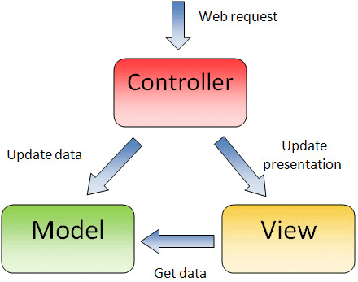



APPROACH USED
MVC(MODAL VIEW CONTROLLER)

Slide 7
DATABASE
ADMIN
CUSTOMER
PACKAGE PLAN

Slide 8
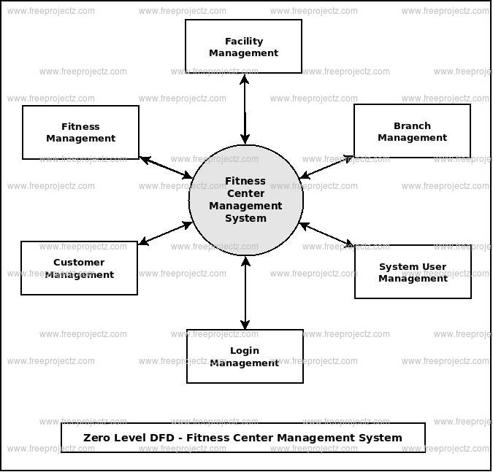
DATA FLOW DIAGRAM

Slide 9
TECHNOLOGY USED
⇧ Google drive Eclipse J2EE
⇧ Microsoft Windows 10
⇧ HTML: Used for the development and maintenance of the group web page.
⇧ CSS : used for styling
⇧ Bootstrap: used for responsiveness
⇧ ORACLE Database Server

Slide 10
SUMMARY
Title : GYM MANAGEMENT SYSTEM
Definition : To manage the fitness with current and potential customer's and provide daily workout details and diet plan
Team Size : 4
Team Members :Shivangi Tyagi
Suhail
Sachin Sharma
Ayush
Software Requirements : Ecillipse IDE, Apache Tomcat server Development Platform : Microsoft Visual Studio2008
Front-end-tool : HTML, CSS, BOOTSTRAP, JAVASCRIPT
Back-end-tool : JAVA, JSP, SERVLET, MySQL

Slide 11
DEMO TIME

Slide 12
Any Questions ???
GOOD- BYE
Thank You

